Slide 1
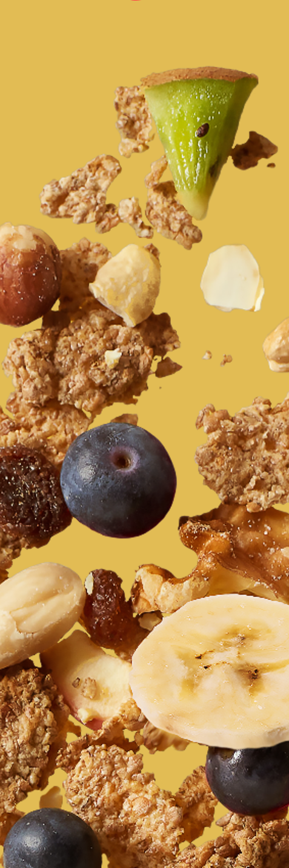
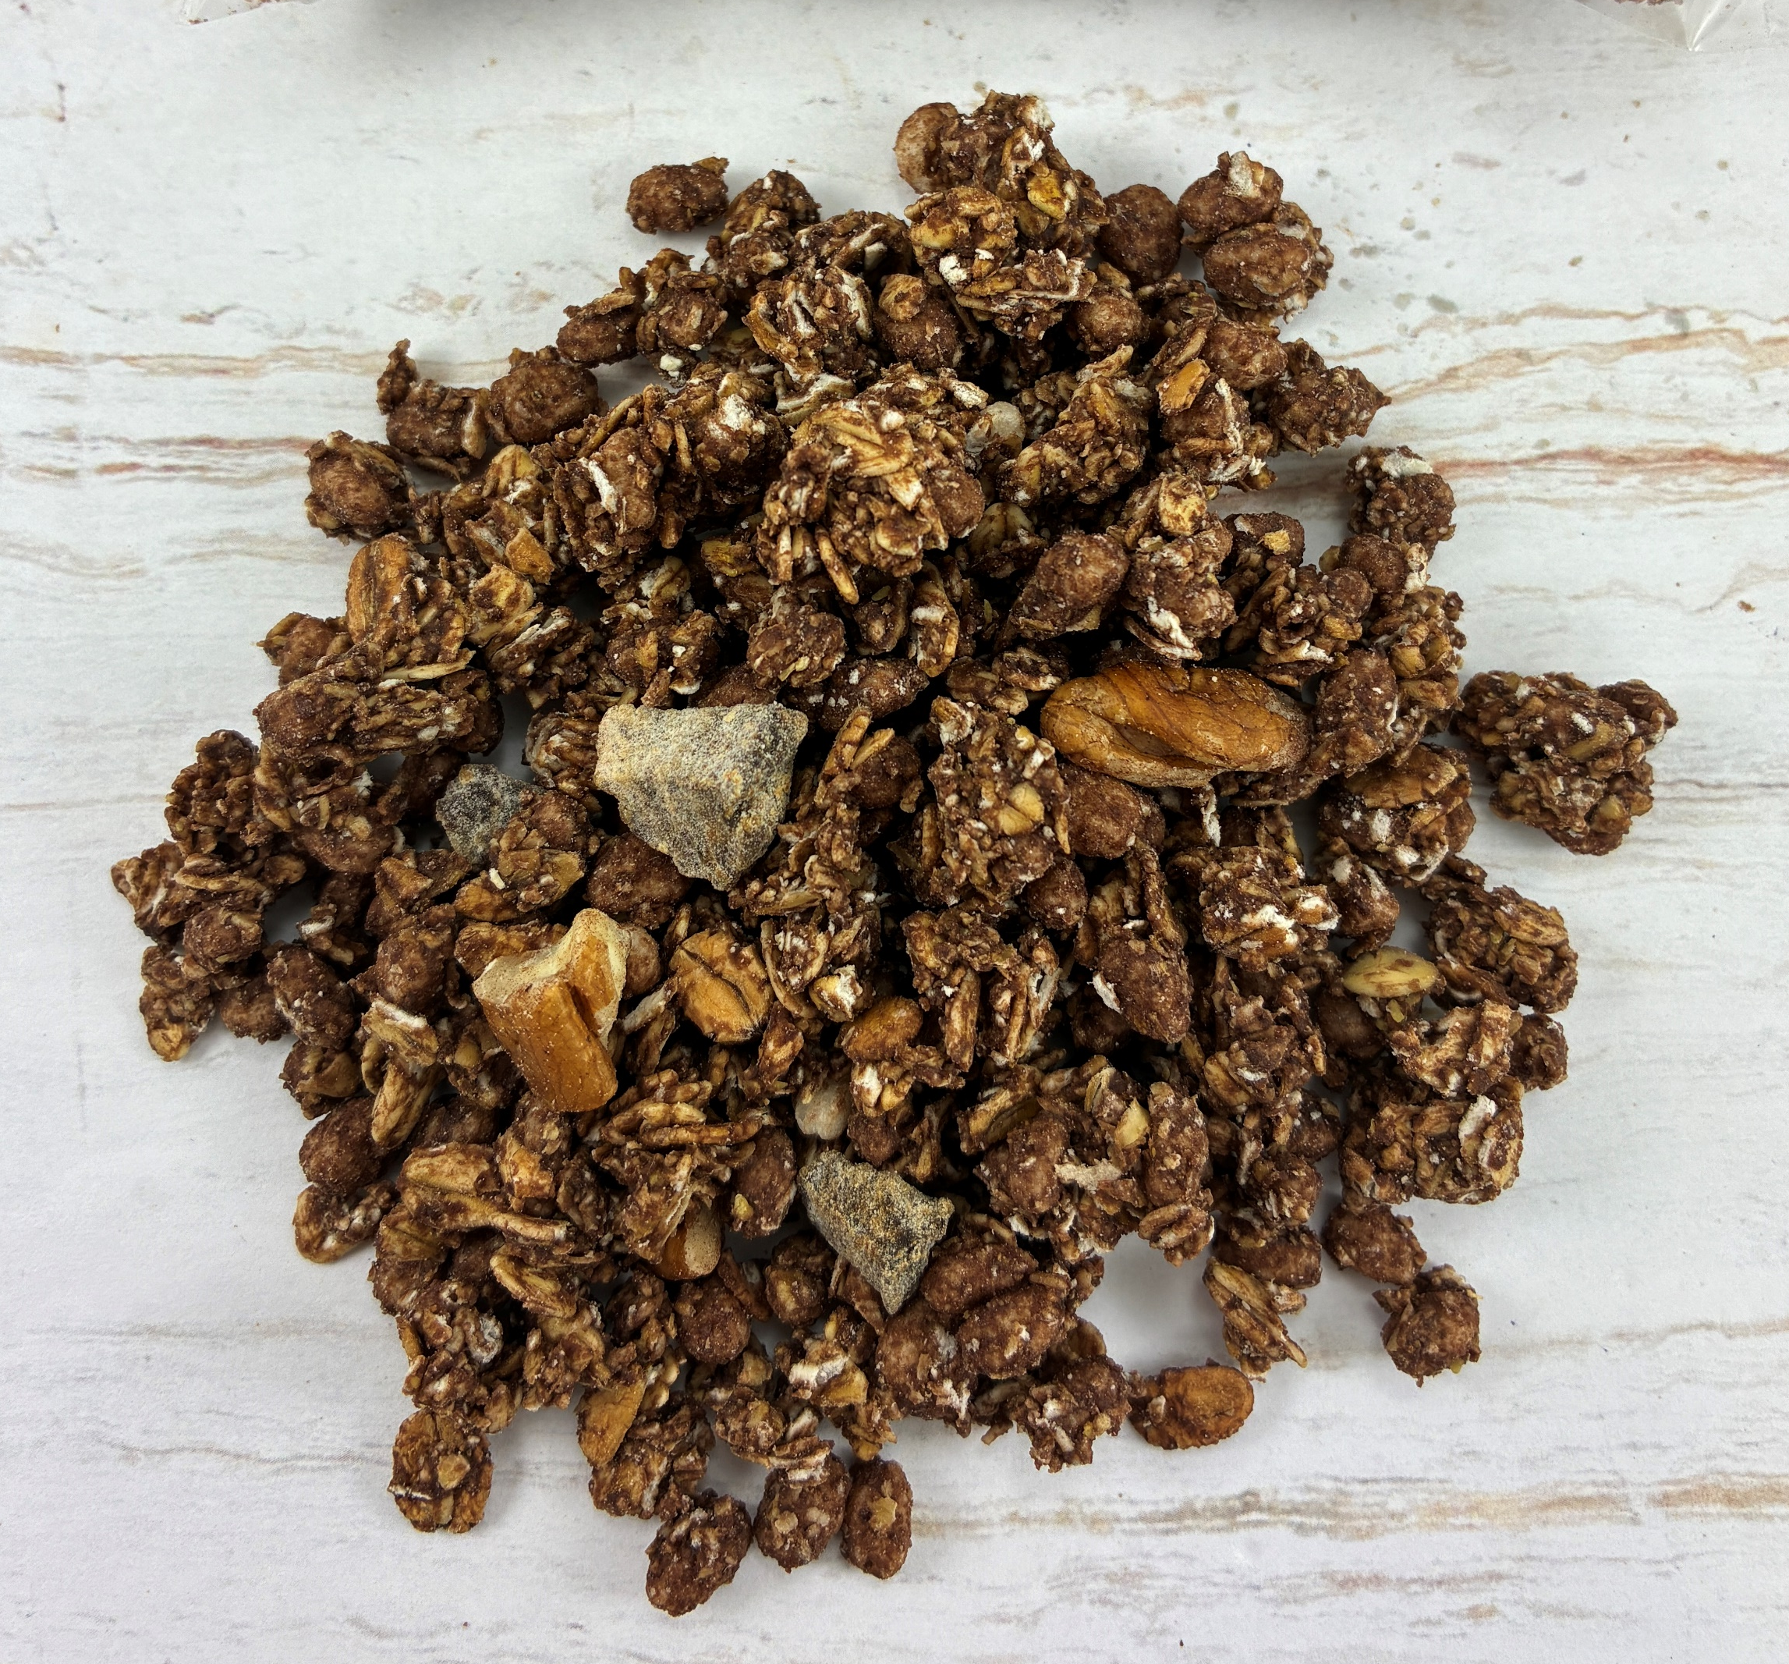

crunchy cocoa muesli with banana and pecan nuts (RAC) – V2– with sweetener ref.: 000004010870
Ingredients |  | In %
crunchy muesli with cocoa and sweetener | wholegrain OAT flakes, sweetener: maltitol, whole grain SPELT flakes, extruded rice cereals (rice flour), WHEAT flour, sunflower oil (with antioxidant: tocopherol-rich extracts), cocoa powder, natural flavouring type banana | 93,5
dried banana pieces | banana, anti-caking agent: rice flour | 4
PECAN NUT pieces |  | 2,5
Nutrition information | per 100g | per 50 g
kJ calories | 1702 406 | 851 203
Fat (g) of which saturates (g) | 12,3 1,8 | 6,1 0,9
Carbohydrates (g) of which total sugars (g) | 65,6 2,6 | 32,8 1,3
Polyols (g) | 14,8 | 7,4
Fibre (g) | 7,5 | 3,8
Protein (g) | 10,4 | 5,2
Salt (g) | 0,04 | 0,02
Description of product :
This crunchy muesli is a mixture of whole grain rolled oat and spelt flakes, rice extrudate and other ingredients. It obtains its crunchiness through a final baking process. The product is enhanced by adding banana pieces and pecan nut pieces.
Allergen information :
Contains allergens according to the list of ingredients. Manufactured in a facility where the following allergens are present: cereals containing gluten, peanuts, sesame, nuts, milk and soya products, mustard, lupin.
Claims
wholegrain content: 52 % high source of fibre low in sugar very low in salt
Storage conditions :
12 months in original package at temperatures below 20 °C and less than 60 % relative air humidity

